Slide 1

Introduction to Operating Systems CS/COE 1550
Summer 2020-2021
Sherif Khattab
ksm73@pitt.edu
(Some slides are from Silberschatz, Galvin and Gagne ©2013)

Slide 2
Announcements
Upcoming deadlines:
Homework 2 and Lab 1: due on 6/4
Project 1: due on 6/14
Piazza is the main communication mechanism with the teaching team

Slide 3
Last Lecture …
Spinlocks
How to use
How to implement
Spinlock problems
Semaphores
Usage

Slide 4
Muddiest Points (1/2)
Xv6 in general
Differences between I/O and CPU bound processes
Semaphores
Situations where counting semaphores are used
Spinlocks made sense but I was having a hard time grasping semaphores.
how semaphores aren't busy waiting
what is busy wait
When to use a spinlock vs when to use a semaphore
could we go more in depth on use cases for counting semaphores?
The difference between TestAndSet & Swap
for slide "Busy waiting vs. Blocking" where a blocked processes gets added to the waiting queue, does the process get notified when it can continue (when resources free up), or does something frequently check if it can go back into ready/run state?
If x86 doesn't use threads, what's the advantage? I would think relying only on process creation would use more resources than thread creation from the drawing.
How are processes blocked by a semaphore alerted once the executing process has finished?
I'm going to have trouble implementing spin-locks/semaphores in C.

Slide 5
Muddiest Points (2/2)
Threads vs. Processes
how exactly the semaphore code structure makes it superior to spinlock
why semaphores have an empty while loop but aren't considered to be busy waiting
things are becoming more and more difficult and abstract...
how to map what we have learned today to the project
The differences in implementation of spinlock with test & set versus atomic swap
What is inside Test and Set
Spinlock implementation. I think it is just hard for me to visualize.
blocking vs busy waiting
Usage of locks
identifying critical regions
Where the memory that the critical sections deal with is stored
bounded buffer problem
"No assumptions about speed of CPU" in critical region problem
The last Tophat question:
In busy waiting, what happens when process A tries to access a critical section while process B is already in the critical section?

Slide 6
Today’s Agenda …
Semaphore
Implementation
Types
Problems
Monitors
Usage
Implementation
Other synchronization mechanisms

Slide 7
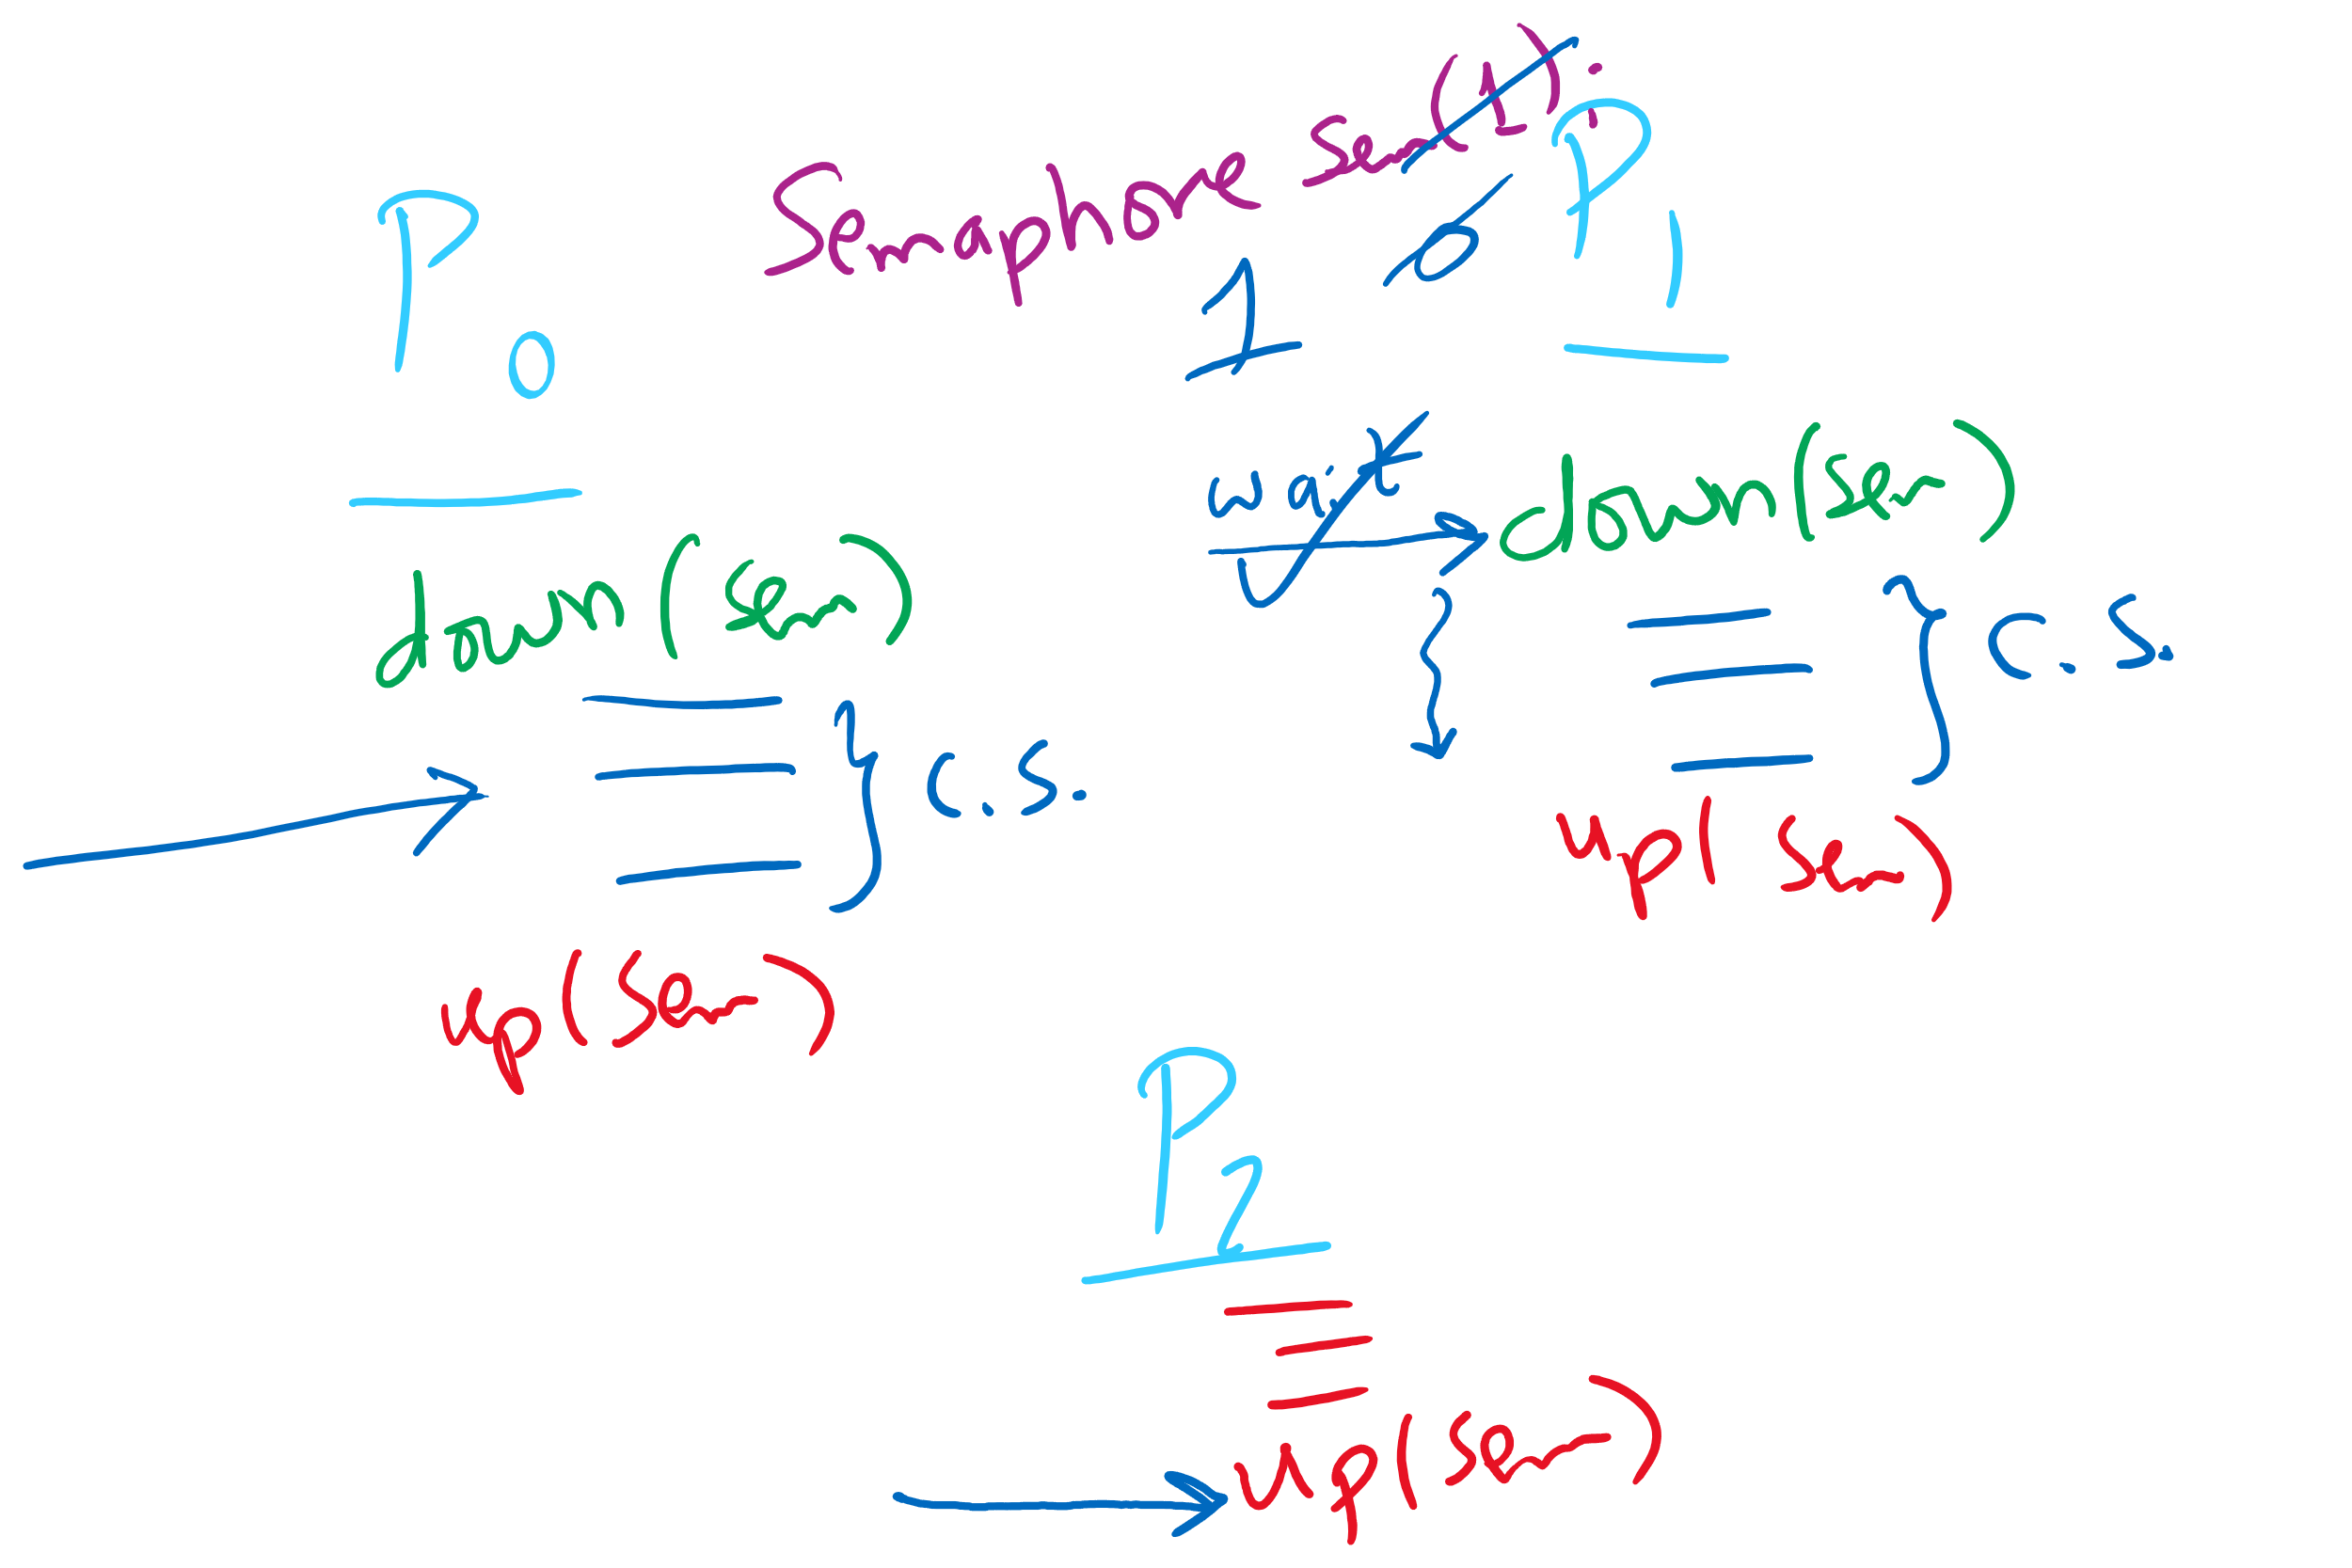
Semaphore Usage Problem: Compromising Mutual Exclusion
Any process can up() the semaphore
Solution: A Mutex can be up()’d only by the same process that down()’d it

Slide 8
Semaphore Usage Problem: Deadlock and Satrvation
Deadlock: two or more processes are waiting indefinitely for an event that can only be caused by a waiting process
P0 gets A, needs B
P1 gets B, needs A
Each process waiting for the other to signal
Starvation: indefinite blocking
Process is never removed from the semaphore queue in which its suspended
May be caused by ordering in queues (priority)
Shared variables
Semaphore A(1),B(1);
Process P₀
A.down();
B.down();
.
.
.
B.up();
A.up();
Process P₁
B.down();
A.down();
.
.
.
A.up();
B.up();

Slide 9
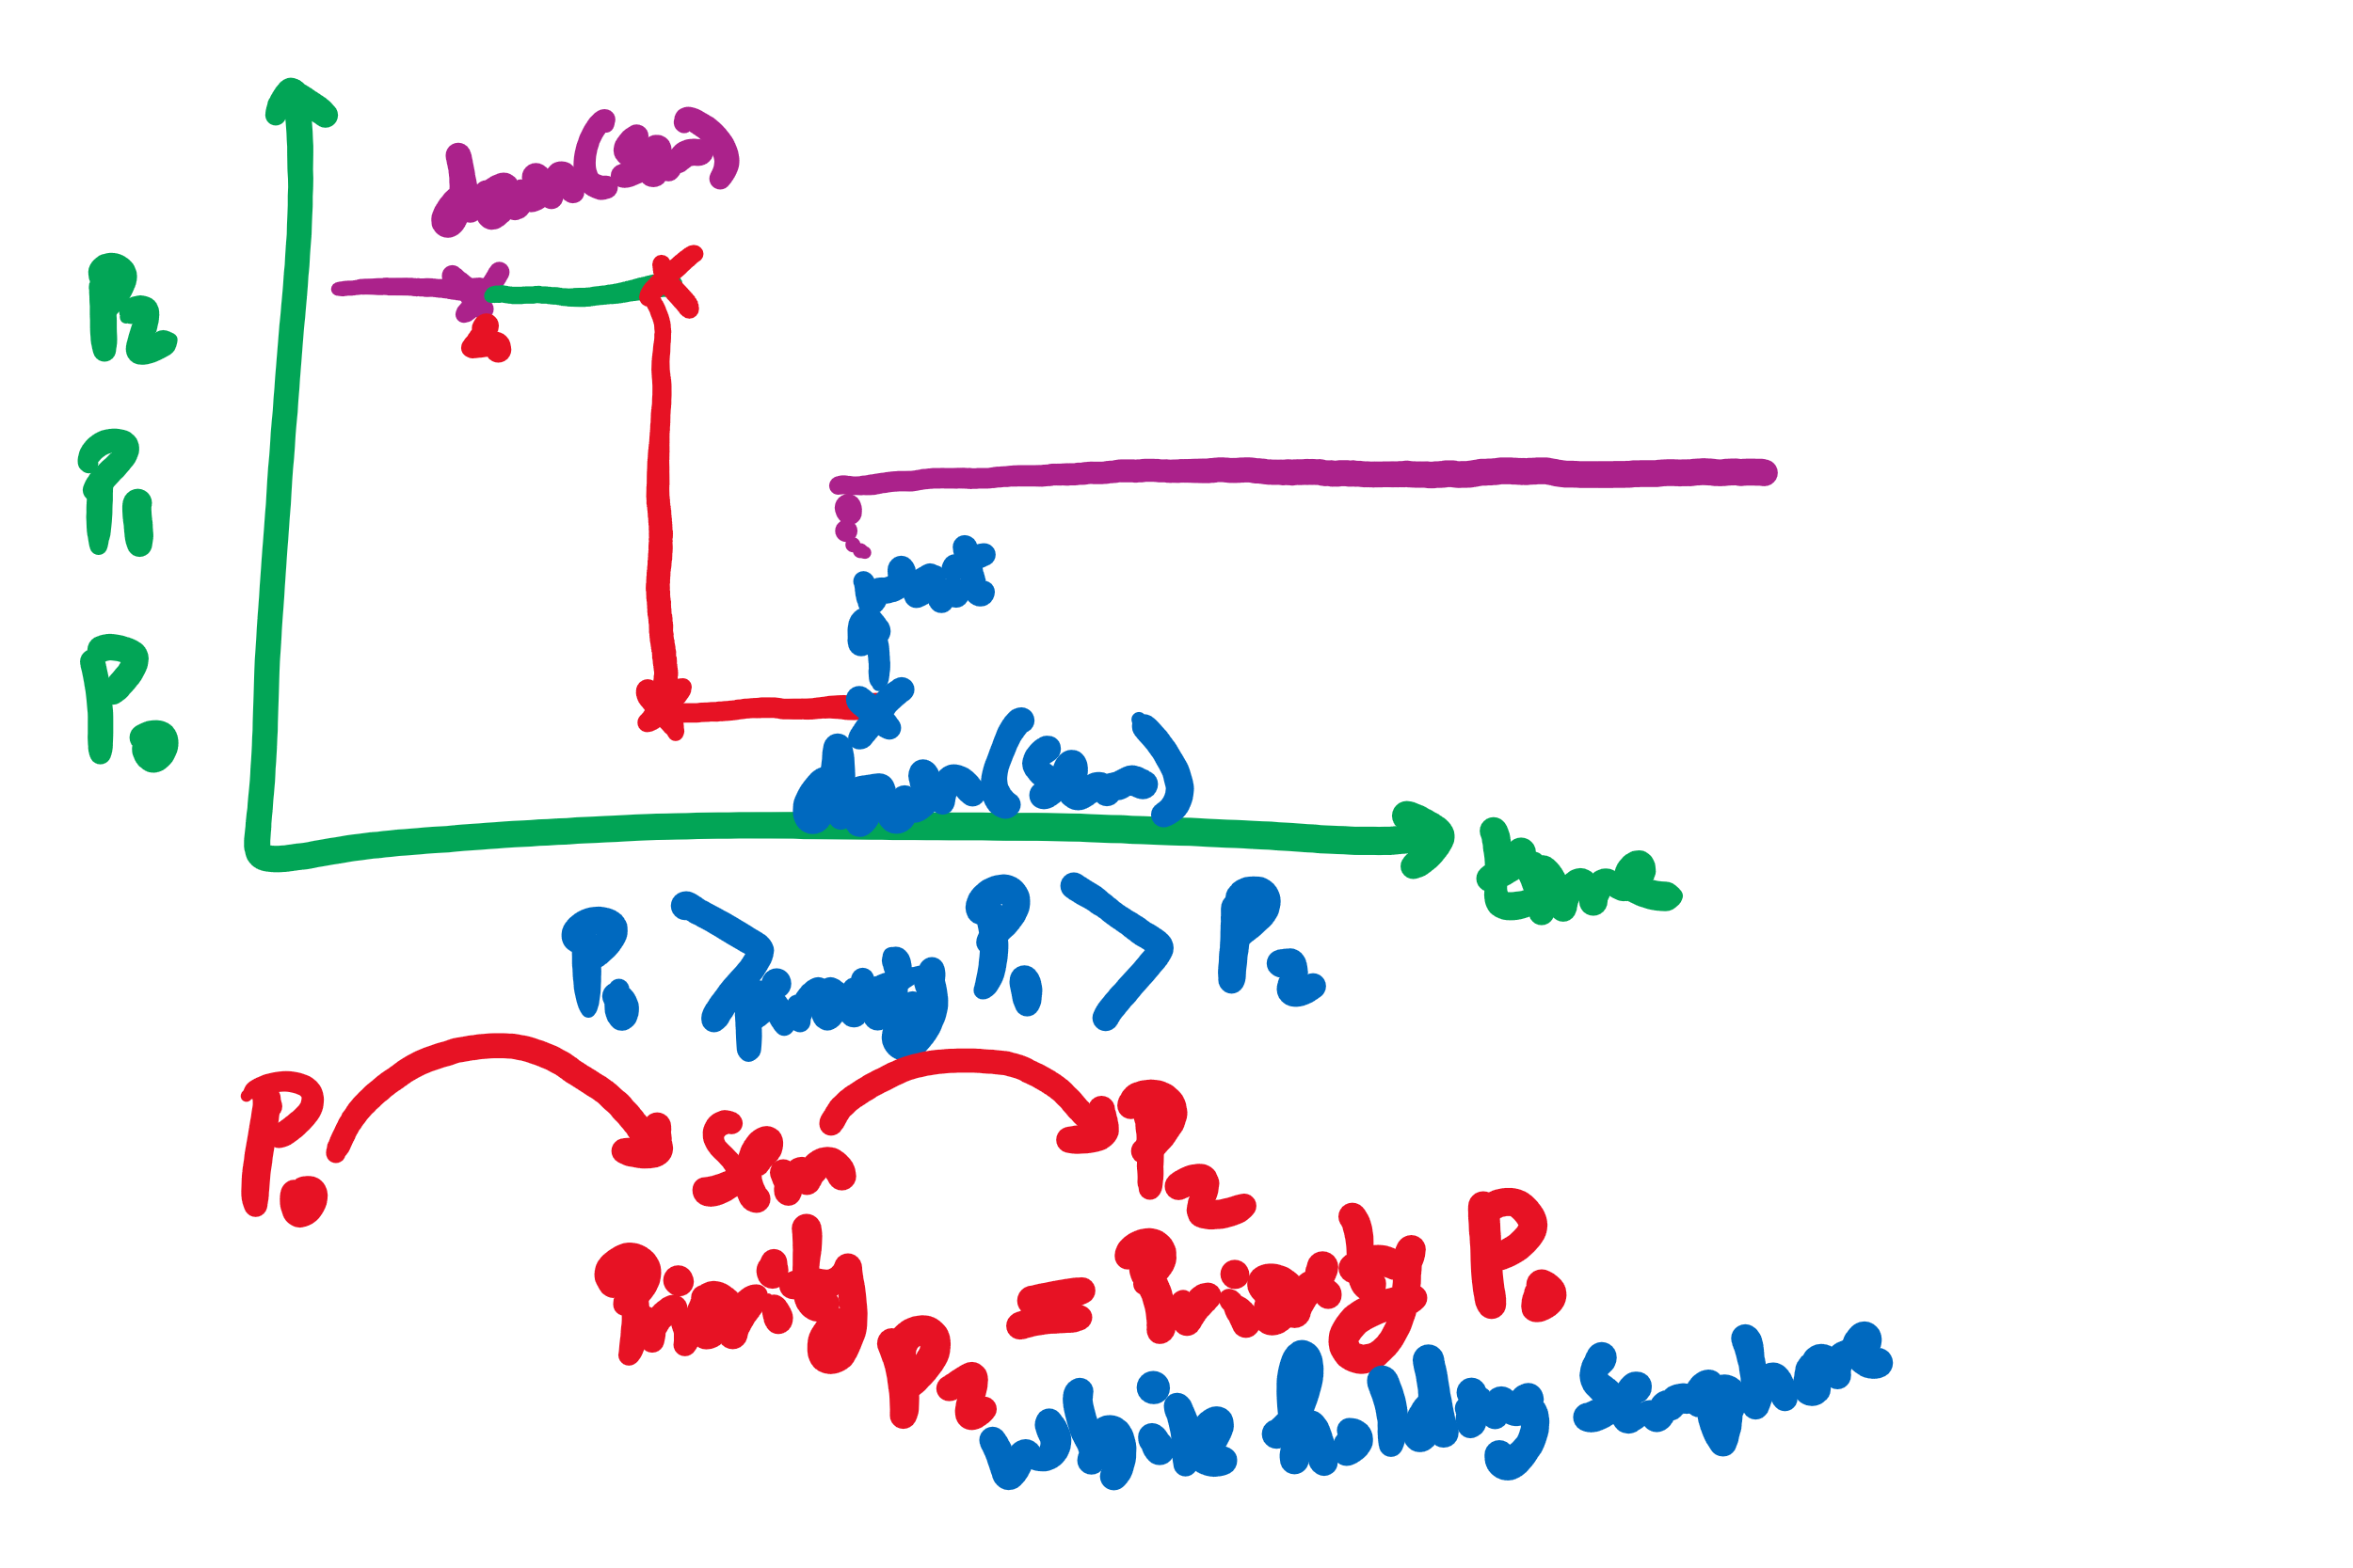
Semaphore Usage Problem: Priority Inversion
Priority inversion is still possible using semaphores
Slightly less likely
Needs at least three processes

Slide 10
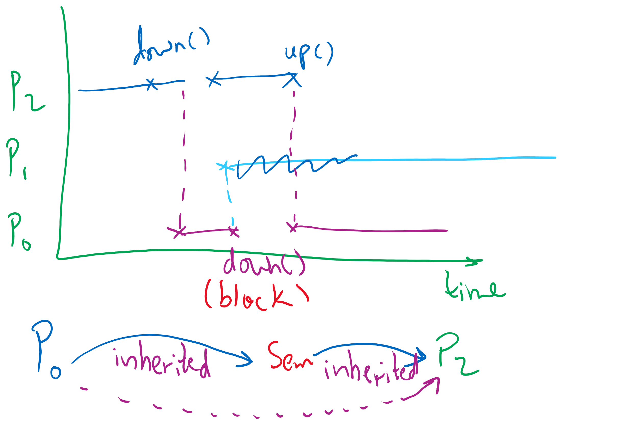
Priority Inheritance

Slide 11
Implementing semaphores with blocking
Assume two operations:
Sleep(): suspends current process
Wakeup(P): allows process P to resume execution
Semaphore data structure
Tracks value of semaphore
Keeps a list of processes waiting for the semaphore
Operations still atomic
Semaphore code
Semaphore::down ()
{
value -= 1;
if (value < 0) {
// add this process to pl
Sleep ();
}
}
Semaphore::up () {
Process P;
value += 1;
if (value <= 0) {
// remove a process P
// from pl
Wakeup (P);
}
}
Semaphore {
int value;
ProcessList pl;
void down ();
void up ();
};
How to protect these shared variables??

Slide 12
Spinlocks in Semaphores
Semaphore code
Semaphore::down ()
{
value -= 1;
if (value < 0) {
// add this process to pl
Sleep ();
}
}
Semaphore::up () {
Process P;
value += 1;
if (value <= 0) {
// remove a process P
// from pl
Wakeup (P);
}
}

Slide 13
Spinlocks are sometimes better than Semaphores
Multiple cores
Very (very) short waiting time to enter the critical section
< context-switching time
Few contending processes
Short critical section code

Slide 14
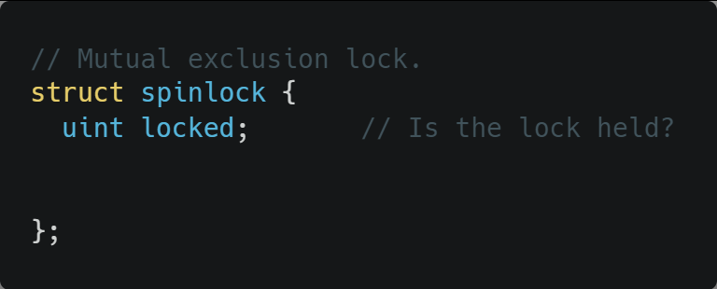
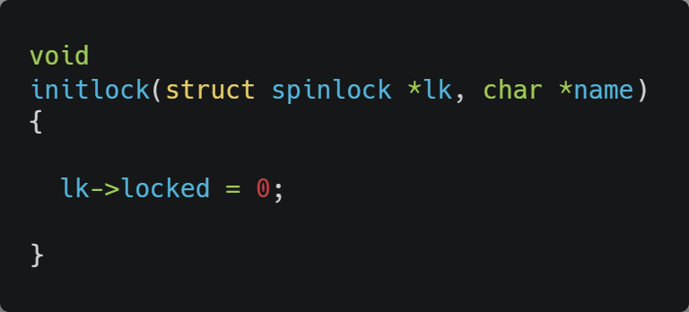
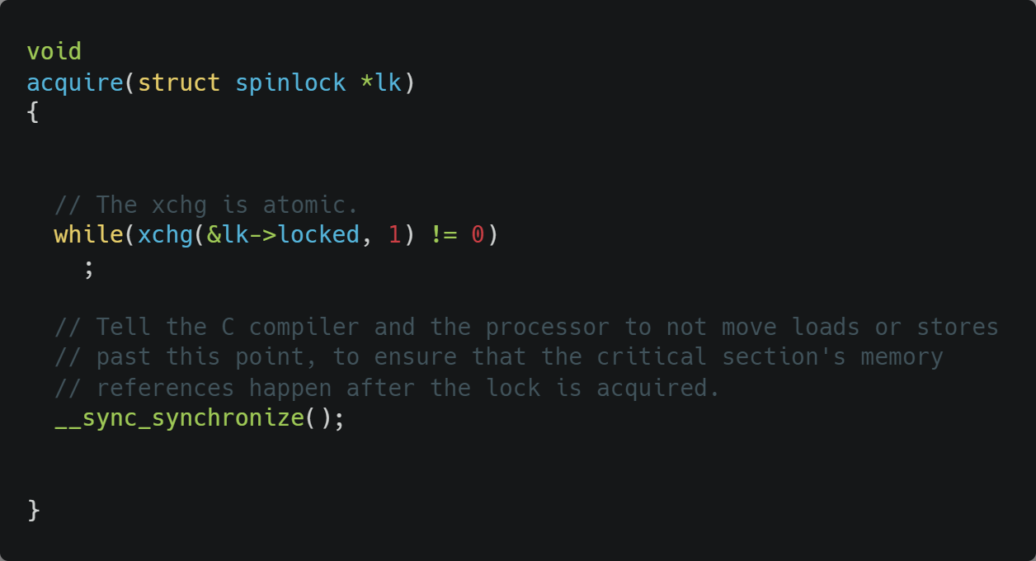
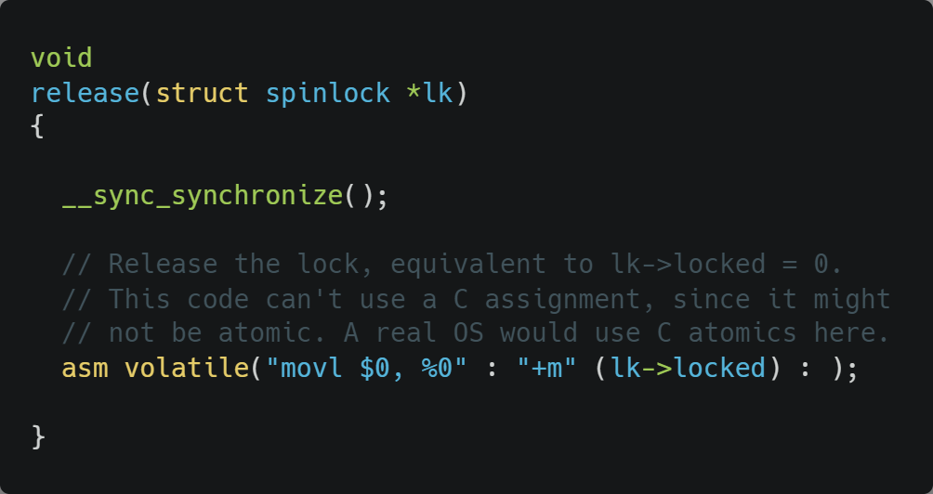
Xv6 Walkthrough
Spinlocks

Slide 15
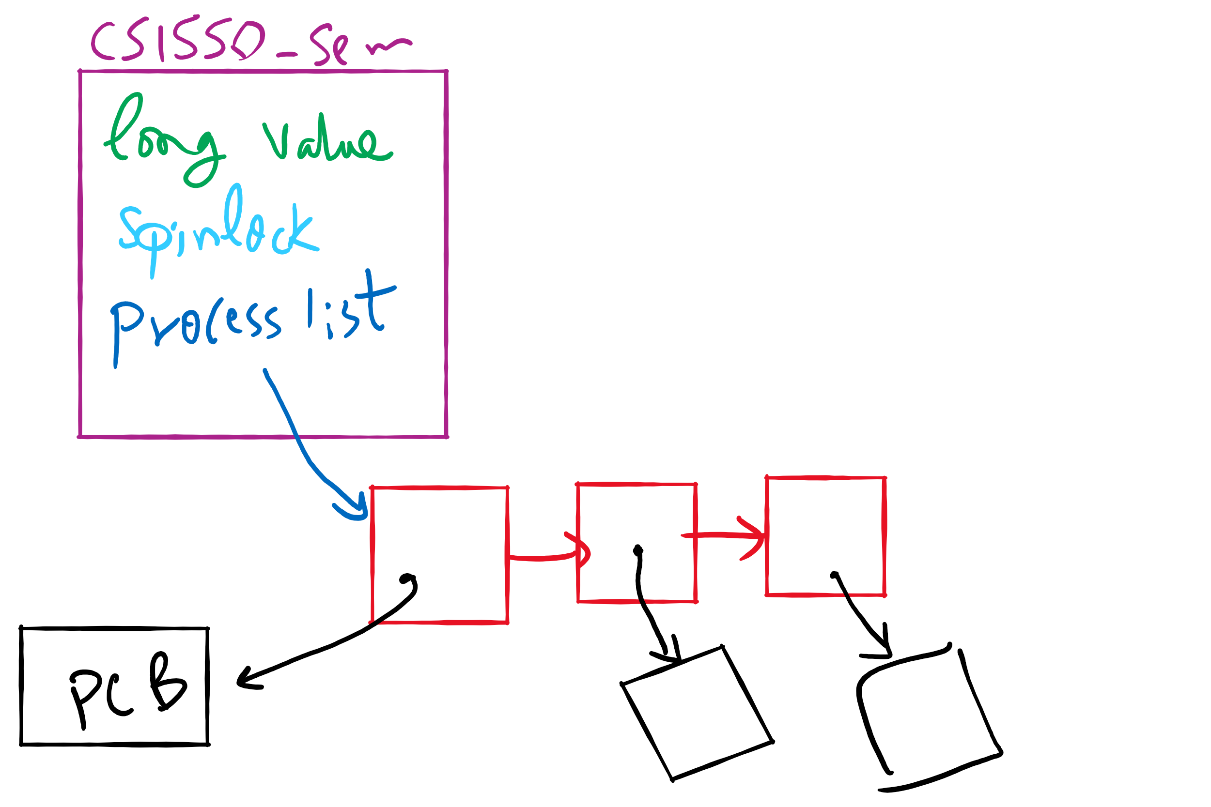
Semaphore Implementation in Project 1

Slide 16
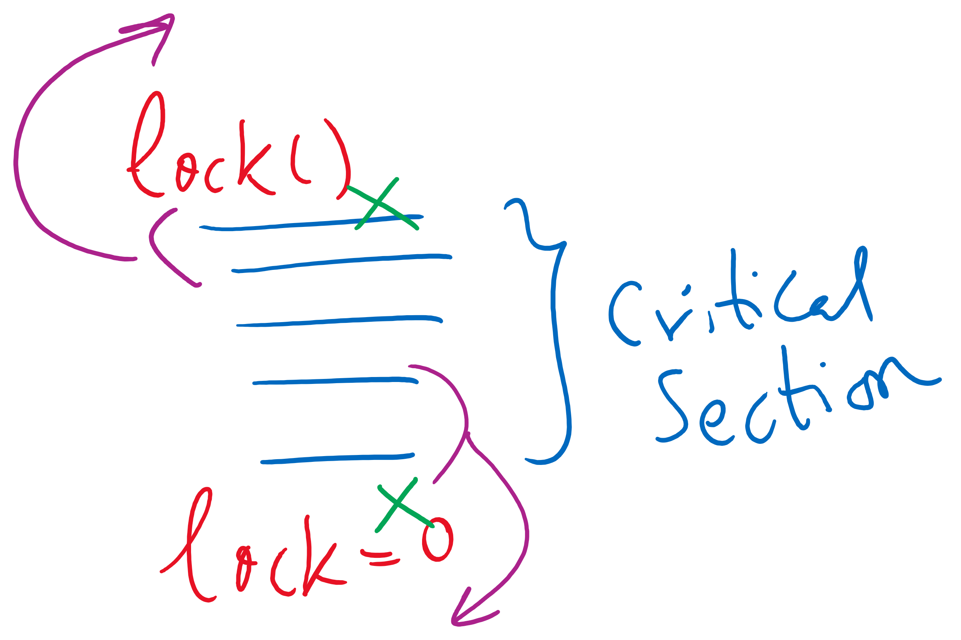
Code reordering

Slide 17
Monitors
A monitor is another kind of high-level synchronization primitive
One monitor has multiple entry points
Think multiple methods in a Java class
Only one process may be in the monitor at any time
Enforces mutual exclusion - less chance for programming errors
Monitors provided by high-level language
Variables belonging to monitor are protected from simultaneous access
Procedures in monitor are guaranteed to have mutual exclusion

Slide 18
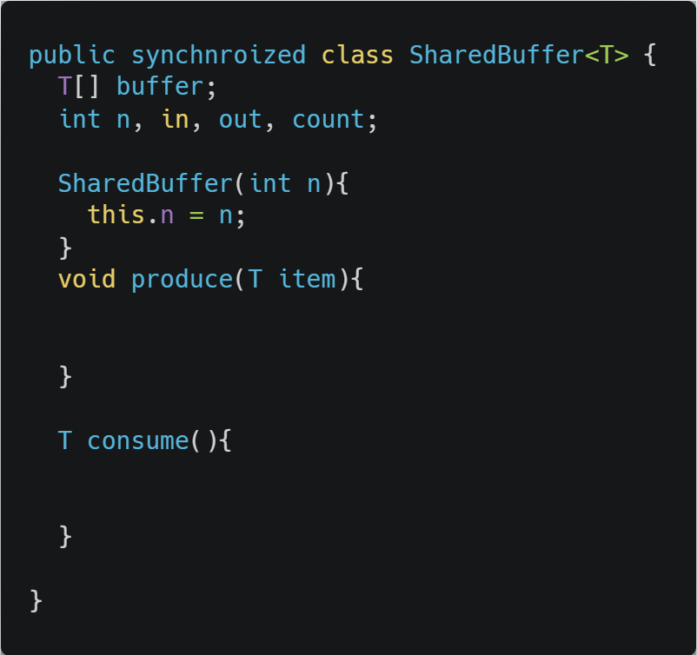
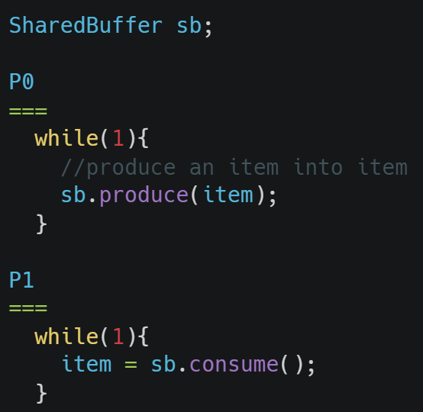
Monitor usage
Supported by Java
synchrnoized keyword
Only one process can be executing in either produce or consume at any time

Slide 19
Condition variables in monitors
Problem: how can a process wait inside a monitor?
Can’t simply sleep: there’s no way for anyone else to enter
Solution: use a condition variable
Condition variables support two operations
Wait(): suspend this process until signaled
Signal(): wake up exactly one process waiting on this condition variable
If no process is waiting, signal has no effect
Signals on condition variables aren’t “saved up”
Different from semaphores!
Condition variables are only usable within monitors
Process must be in monitor to signal on a condition variable

